Slide 1

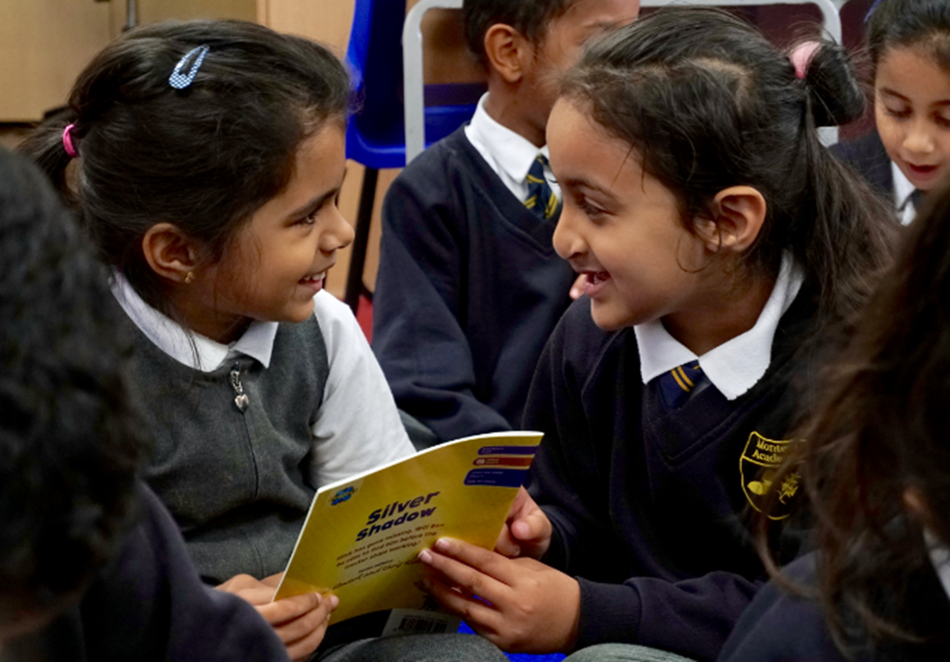

MONTEM ACADEMY CPD
ORACY
The Power of Discussion

Slide 2






ORACY
Oracy refers to the ability to express oneself fluently and effectively through spoken language.
SPEAKING
INTERACTING
The ability to articulate thoughts clearly and coherently, adjusting language and tone for different audiences and contexts.
Engaging in meaningful conversations, asking questions, contributing ideas, and building on others' input in collaborative settings.
LISTENING
THINKING
Actively receiving and understanding spoken messages, with the skill to process, reflect, and respond appropriately.
Using spoken language to reason, problem-solve, and reflect critically, supporting deeper learning and understanding.

Slide 3


THE BENEFITS OF ORACY
Oracy is the ability to speak and listen effectively, which is essential for pupils' development in various aspects of learning.
INCREASED CONFIDENCE
IMPROVED COMMUNICATION SKILLS:
Regular practice of speaking and listening builds pupils' self-esteem and comfort in sharing ideas, boosting their classroom participation.
Oracy helps pupils express their ideas clearly, enhancing their ability to communicate in both academic and social settings.
ENHANCED SOCIAL SKILLS
BETTER CRITICAL THINKING
Oracy encourages collaborative learning, fostering empathy, active listening, and respect for diverse perspectives.
Through discussions and reasoning, pupils develop the ability to think critically and make informed decisions.

Slide 4


01
ORACY FOR LEARNING
04
USING ORACY TO DEVELOP MEMORY
CPD
CONTENT
02
USING ORACY TO DEVELOP ATTENTION
05
USING ORACY TO DEVELOP METACOGNITION AND RETENTION
03
USING ORACY TO DEVELOP HARD THINKING

Slide 5


ORACY
THE CPD AIM
Oracy, which is frequently defined as both learning to talk and learning through talk, plays a key role in primary education.
This CPD session will focus on the importance of using talk as a tool for learning, helping pupils to deepen their understanding through meaningful verbal interactions.
By exposing pupils to high-quality speaking experiences, we aim to enhance their communication skills, boost confidence, and encourage critical thinking.

Slide 6
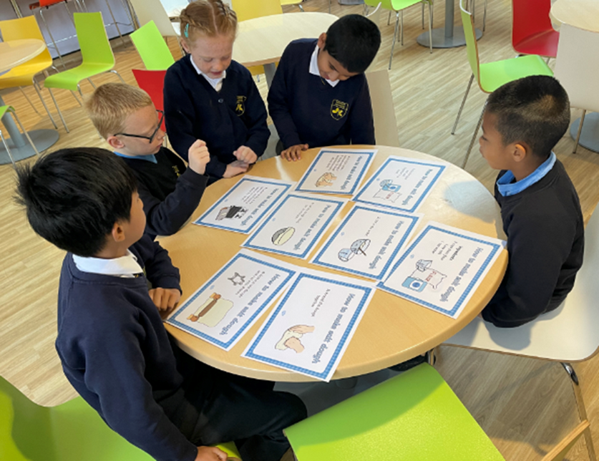
ORACY FOR LEARNING
Oracy for learning supports pupils to actively engage with
learning material through spoken expression.
Research by Sedova and Sedlacek (2023) demonstrates that the ability to use spoken language effectively—commonly referred to as oracy—plays a vital role in enhancing students' cognitive growth and academic success.
Their findings show that when children participate in meaningful, well-structured conversations, they not only develop stronger communication skills but also gain a deeper understanding of subject matter.
Activities such as classroom discussions, collaborative dialogue with peers, and teacher-facilitated conversations contribute to the development of critical thinking, problem-solving, and social-emotional skills.
The study underscores the importance of creating opportunities for high-quality talk in the classroom, highlighting its potential to foster a virtuous cycle of learning and personal growth for all students.

Slide 7

USING ORACY TO DEVELOP ATTENTION
Structured oral activities are highly effective in enhancing student attention. When students engage in discussions, debates, or explanations, they transition from passive learning to active participation.
Activities such as group dialogues and reciprocal teaching encourage attentive listening and sustain engagement by fostering interaction and accountability. These approaches also minimise distractions by promoting continuous involvement.
Research suggests that attention improves when students actively listen, process information, and respond in real time, positioning oracy as a powerful strategy for maintaining focus in the classroom.

Slide 8
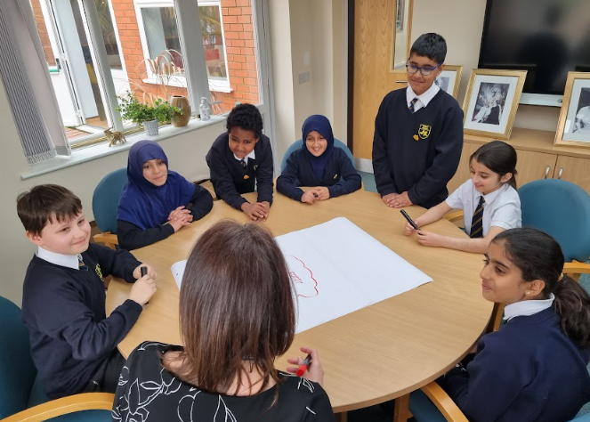
USING ORACY TO DEVELOP THINKING
Engaging in hard thinking requires tackling complex problems and making critical decisions—processes that are greatly enhanced by oracy.
Strategies like Socratic questioning and debate prompt students to think aloud, express their reasoning, and evaluate multiple viewpoints. These methods help learners deconstruct complex concepts and link them to existing knowledge, thereby activating higher-order thinking skills.
By extending cognitive effort beyond written tasks, oracy provides diverse learners with meaningful ways to engage deeply with challenging material.

Slide 9
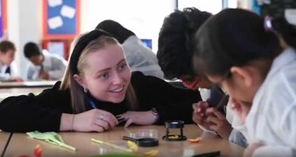
USING ORACY TO MAXIMISE MEMORY
Oracy is crucial for improving memory retention as it shifts learning from passive reception to active engagement.
Techniques such as verbal summarisation, peer teaching, and elaborative questioning stimulate various cognitive pathways, facilitating the transfer of information to long-term memory.
Through interactive discussions, students rehearse and process material in purposeful ways, easing cognitive load and improving recall. This approach aligns with principles from cognitive science, emphasising that retrieval through speaking strengthens memory consolidation.

Slide 10

USING ORACY TO DEVELOP METACOGNITION AND REFLECTION
ORACY FOR LEARNING
Oracy fosters metacognition by prompting students to articulate their thinking and reflect on their learning experiences.
Questions like “What approach did I take to solve this?” or “What could I do differently next time?” help students self-regulate and pinpoint areas for improvement.
Collaborative discussions further enrich this process by introducing students to a variety of strategies and perspectives, cultivating a culture of collective learning and heightened self-awareness. Such reflective practices are essential for nurturing independent, lifelong learners.

Slide 11



