Slide 1





Citizenship
Week 1
Everyone to Excel through Pride and Ambition

Slide 2

Citizenship
Inclusion
Diversity | KS1 Link | https://www.bbc.co.uk/bitesize/topics/zyg2xbk/articles/z9dpn9q (first video on the page - 'Explore diversity')
Identity and Values | KS2 Link | https://www.youtube.com/watch?v=om3INBWfoxY

Slide 3


Citizenship
Safeguarding
Who helps us? | KS1 Link | https://www.youtube.com/watch?v=iuJE36d2eS0&list=PLemcx8qcUKRyHcJTb8qqHUiRejJ-TsLq2&index=53
Looking after mental health | KS2 Link | https://www.youtube.com/watch?v=Vrjlq2R3vVc&list=PL-2SkY8uS2lLi4DZDREQZ7MoXKpjuU0YN&index=11
Notes:
Click on the link for the video and then create a short task/question based on the video.

Slide 4


Citizenship
ECO
5TH JUNE - WORLD ENVIRONMENT DAY
https://www.worldenvironmentday.global/about/theme-host
Notes:
Click on the link for the video and then create a short task/question based on the video.

Slide 5
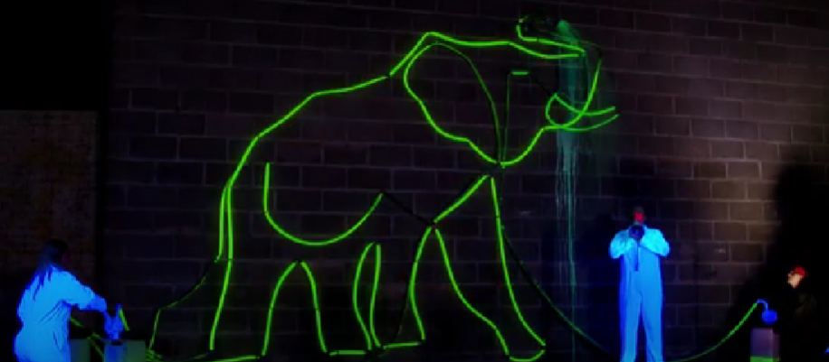

Citizenship
Arts
https://www.youtube.com/watch?v=9aNaleGQE80
Notes:
Click on the link for the video and then create a short task/question based on the video.

Slide 6


Citizenship
Sports
https://drive.google.com/file/d/1w5SbB2Y2Oi6FsPYF52tkYP51hVmDNiiz/view
Notes:
Click on the link for the video and then create a short task/question based on the video.

