Slide 1





Citizenship
Week 6
Everyone to Excel through Pride and Ambition

Slide 2


Citizenship
Inclusion
KS1 Link | https://www.youtube.com/watch?v=tgF1Enrgo2g
KS2 Link
Notes:
Click on the link for the video and then create a short task/question based on the video.

Slide 3


Citizenship
ECO
5 Incredible Eco-Friendly Innovations To Save The Earth - YouTube
Notes:
Click on the link for the video and then create a short task/question based on the video.

Slide 4


Citizenship
Safeguarding
KS1 Link | https://www.youtube.com/watch?app=desktop&v=JkDkJmbdxVQ&feature=youtu.be
KS2 Link | https://www.youtube.com/watch?v=zeu9X88g8DE
Notes:
Click on the link for the video and then create a short task/question based on the video.

Slide 5
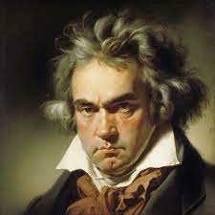

Citizenship
Arts
Beethoven
https://www.youtube.com/watch?v=n3EiRynr1Us
Notes:
Click on the link for the video and then create a short task/question based on the video.

Slide 6

Citizenship
Sports
https://www.youtube.com/watch?v=wUEl8KrMz14
Why is sitting bad for you?
Notes:
Click on the link for the video and then create a short task/question based on the video.

