Slide 1





Citizenship
Week 3
Everyone to Excel through Pride and Ambition

Slide 2

Citizenship
World Wildlife Day
https://wildlifeday.org/en
Everyone to Excel through Pride and Ambition

Slide 3

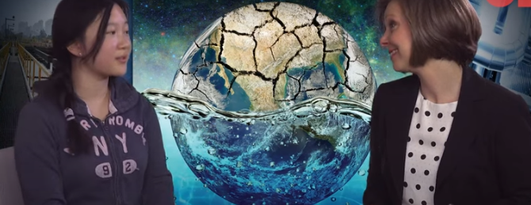

Citizenship
ECO
Anna Du’s Plastic Searching Robot
https://superkind.org/change-makers/anna-du
Notes:
Click on the link for the video and then create a short task/question based on the video.

Slide 4


Citizenship
Safeguarding
https://www.youtube.com/watch?app=desktop&v=CNxNIsQ_SzY (from to 7 minutes - end)
Notes:
Click on the link for the video and then create a short task/question based on the video.

Slide 5
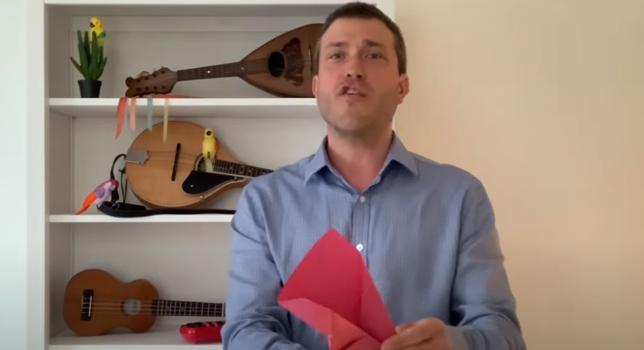

Citizenship
Arts
https://www.youtube.com/watch?v=VO0whvQ3QJA
Watch 10-15 minutes
Notes:
Click on the link for the video and then create a short task/question based on the video.

Slide 6
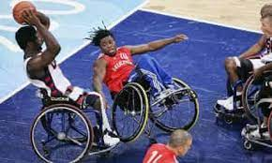

Citizenship
Sports
Ade Adepitan – Paralympian
https://www.youtube.com/watch?v=IkT83crXXAA
Notes:
Click on the link for the video and then create a short task/question based on the video.

