Slide 1





Citizenship
Week 1
Everyone to Excel through Pride and Ambition

Slide 2

Citizenship
Kindness Week
KS2 - https://www.randomactsofkindness.org/kindness-videos/19-kindness-can-be-the-norm
KS1- https://www.youtube.com/watch?v=-SpygGx05tQ
Everyone to Excel through Pride and Ambition

Slide 3
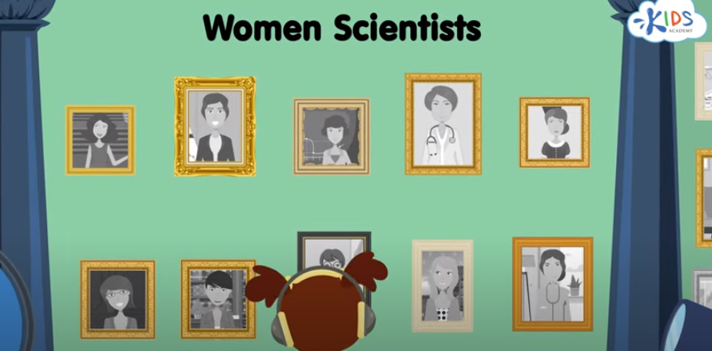
Citizenship
Women in Science Day
https://www.youtube.com/watch?v=VsDHsKiOWag
Everyone to Excel through Pride and Ambition

Slide 4


Citizenship
Safeguarding
https://www.bbc.co.uk/newsround/av/67462322
Notes:
Click on the link for the video and then create a short task/question based on the video.

Slide 5
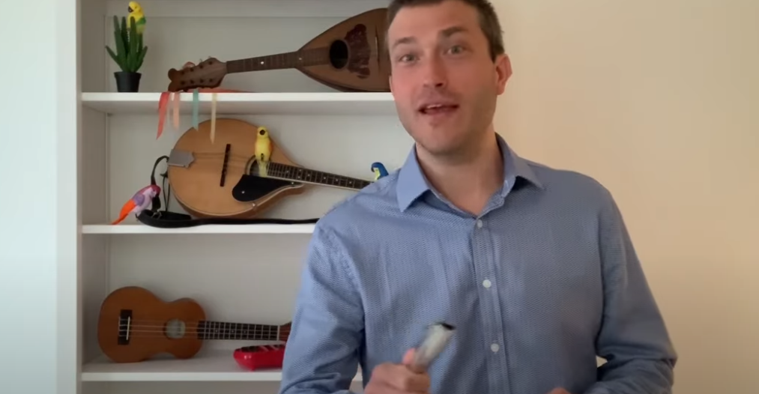

Citizenship
Arts
https://www.youtube.com/watch?v=VO0whvQ3QJA
Watch 0-5 minutes
Notes:
Click on the link for the video and then create a short task/question based on the video.

Slide 6
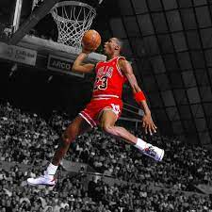

Citizenship
Sports
Motivational Success Story Of Michael Jordan
https://www.youtube.com/watch?v=FbCP4WMwu_M
Notes:
Click on the link for the video and then create a short task/question based on the video.

