Slide 1





Citizenship
Week 4
Everyone to Excel through Pride and Ambition

Slide 2



Citizenship
ECO
Craig Kielburger – fighting to end child labour since he was 12 years old
https://superkind.org/change-makers/craig-kielburger
Notes:
Click on the link for the video and then create a short task/question based on the video.

Slide 3


Citizenship
Safeguarding
Water Safety | KS1 Link | https://rnli.org/youth-education/education-resources/lower-primary/is-this-safe (video at the bottom called 'Going For a Walk with Teddy')
 | KS2 Link | https://learnliveuk.com/water-safe-friendly/ KS2 - 9:45-end (input bkershawma@theparkfederation.org to access)
Notes:
Click on the link for the video and then create a short task/question based on the video.

Slide 4
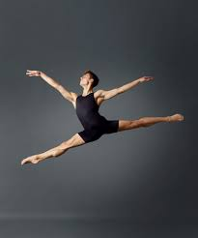

Citizenship
Arts
https://www.youtube.com/watch?v=XbMl_RDGLlY
Notes:
Click on the link for the video and then create a short task/question based on the video.

Slide 5
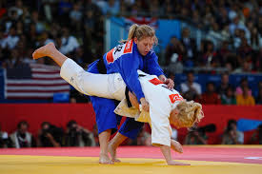

Citizenship
Sports
Gemma Gibbons
https://www.youtube.com/watch?v=55k2ajBA8pY&list=PLcvEcrsF_9zLiSsK0i03cYRbzLhVRIfQE&index=7
Notes:
Click on the link for the video and then create a short task/question based on the video.

