Slide 1





Citizenship
Week 5
Everyone to Excel through Pride and Ambition

Slide 2
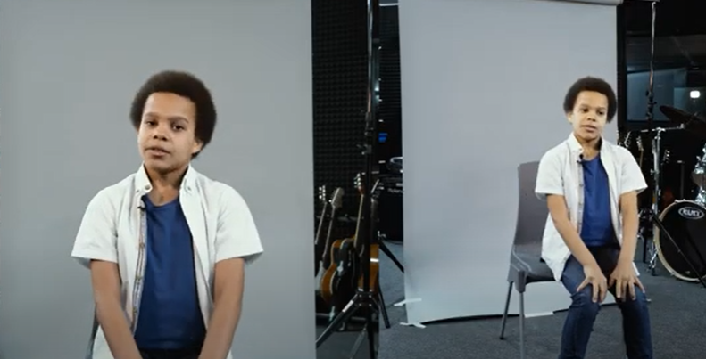
Citizenship
Inclusion
Jack's Story | KS1 Link | https://www.youtube.com/watch?v=rAVv3XLtY94&list=PL-2SkY8uS2lKc6XJsgM9gXwop3ek1cHTP
 | KS2 Link
 | YEAR 6 | https://www.youtube.com/watch?v=q9rSF9efVfk

Slide 3

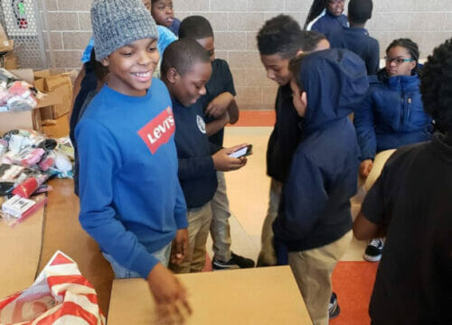

Citizenship
ECO
Jahkil Jackson – helping homeless people since he was 5 years old
https://superkind.org/change-makers/jahkil-jackson
Notes:
Click on the link for the video and then create a short task/question based on the video.

Slide 4
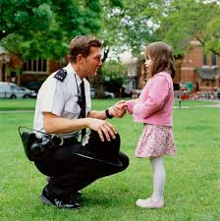

Citizenship
Safeguarding
Getting Lost | KS1 Link | https://www.youtube.com/watch?v=wWfu6XCsVZ8
Beach Safety | KS2 Link | https://www.youtube.com/watch?v=5LkpG11DIPg
Notes:
Click on the link for the video and then create a short task/question based on the video.

Slide 5
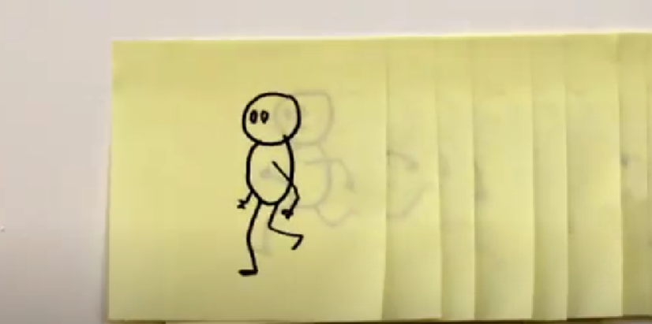

Citizenship
Arts
https://www.youtube.com/watch?v=UC3PB06rLQM
Notes:
Click on the link for the video and then create a short task/question based on the video.

Slide 6


Citizenship
Sports
https://drive.google.com/file/d/1AoXc7C8wE30espaVdVV9ny4EAX1avEXX/view
Notes:
Click on the link for the video and then create a short task/question based on the video.

