Slide 1





Citizenship
Week 5
THE ARTS!
Everyone to Excel through Pride and Ambition

Slide 2
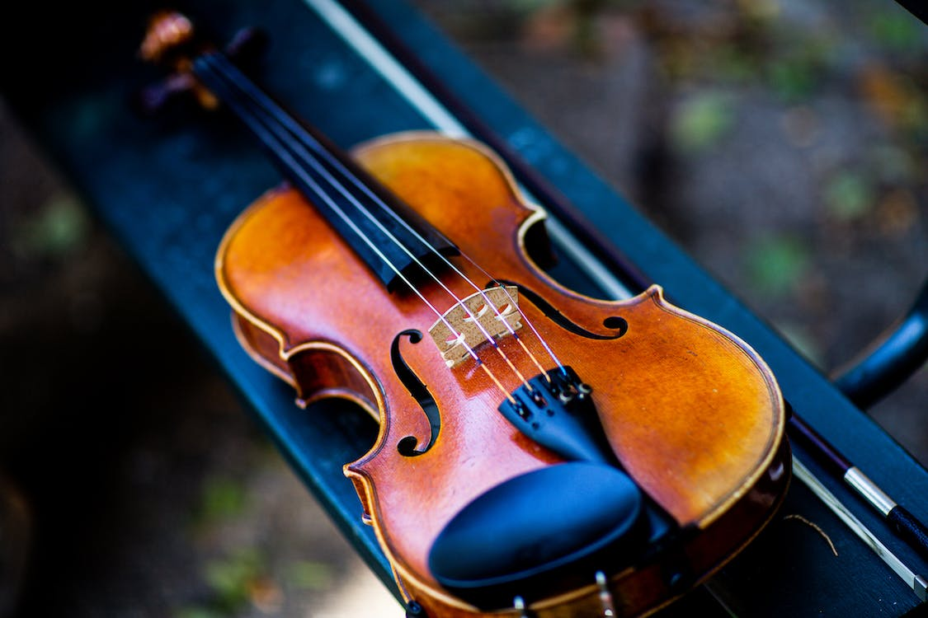


Citizenship
The Arts
Violin
https://www.youtube.com/watch?v=UyloZl2MfgU
Notes:
Click on the link for the video and then create a short task/question based on the video.

Slide 3

Citizenship
Mental Health Awareness Day
KS1 - https://www.youtube.com/watch?v=tY8NY6CMDFA
KS2 - https://www.youtube.com/watch?v=49mfPFTZsHs
Notes:
Click on the link for the video and then create a short task/question based on the video.

Slide 4
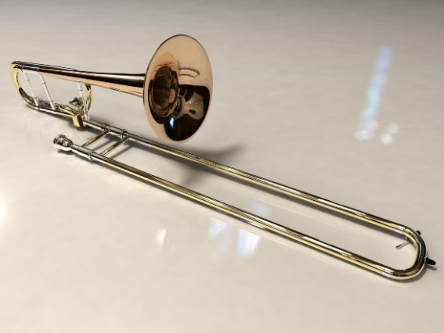
Citizenship
The Arts
Trombone
https://www.youtube.com/watch?v=bf_I0tRLfh4
Notes:
Click on the link for the video and then create a short task/question based on the video.

Slide 5
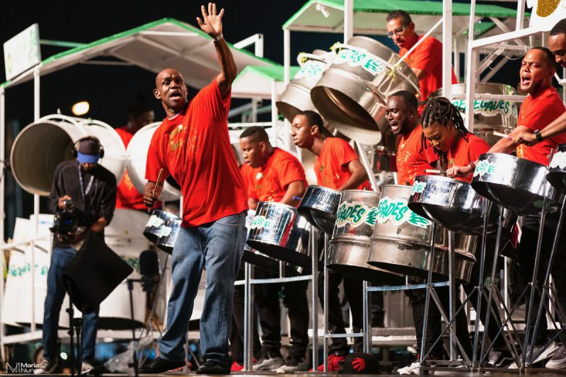
Citizenship
The Arts
Steel Pans
https://www.youtube.com/watch?v=SV7zMhebPT8
Notes:
Click on the link for the video and then create a short task/question based on the video.

Slide 6
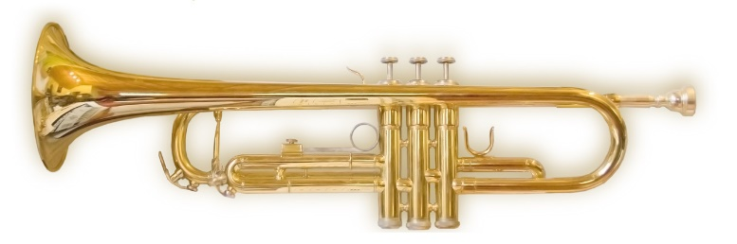
Citizenship
The Arts
Trumpet
https://www.youtube.com/watch?v=5drYSu_xORw
Notes:
Click on the link for the video and then create a short task/question based on the video.

