Slide 1





Citizenship
Week 3
Everyone to Excel through Pride and Ambition

Slide 2

Citizenship
Inclusion
https://www.bbc.co.uk/bitesize/topics/zhfdjsg/articles/zqkptrd (first video on the page - 'Exploring differences’) KS1
https://www.bbc.co.uk/bitesize/topics/zyg2xbk/articles/z9dpn9q (first video on the page - 'Explore diversity’) KS2
Notes:
Click on the link for the video and then create a short task/question based on the video.

Slide 3
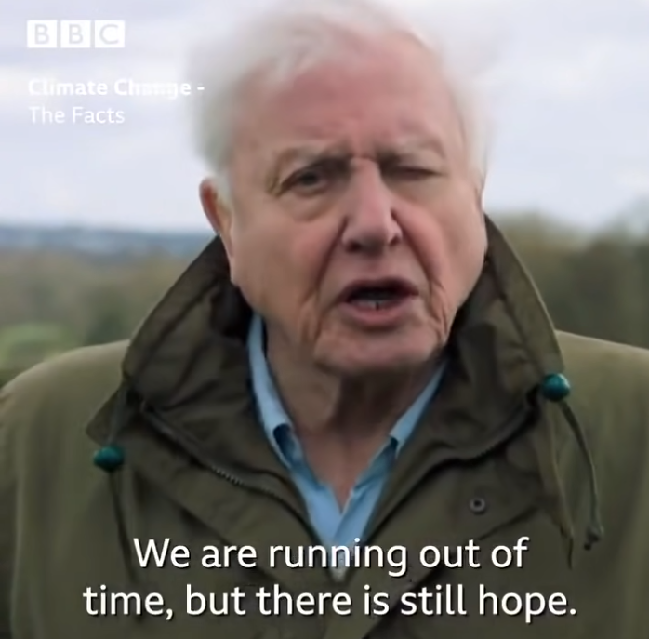

Citizenship
ECO
https://www.youtube.com/watch?v=CMOEcUPGi9c
Notes:
Click on the link for the video and then create a short task/question based on the video.

Slide 4

Citizenship
Safeguarding
https://www.childnet.com/resources/smartie-the-penguin KS1
https://www.childnet.com/resources/video-lessons KS2
Notes:
Click on the link for the video and then create a short task/question based on the video.

Slide 5
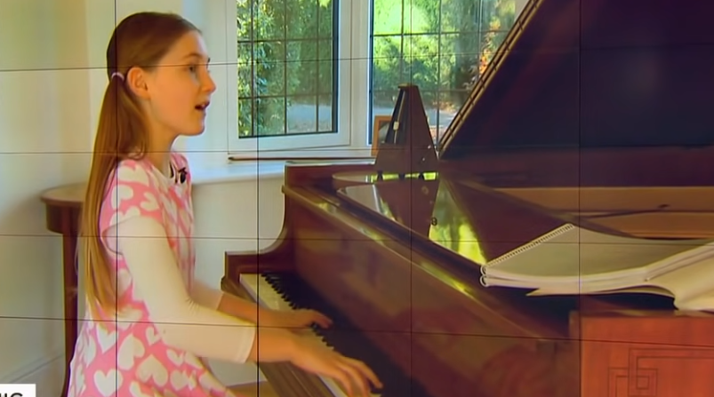

Citizenship
Arts
https://www.youtube.com/watch?v=uh8zh0W0As0
Notes:
Click on the link for the video and then create a short task/question based on the video.

Slide 6

Citizenship
Sports
https://drive.google.com/file/d/1XxzCT7lCZDWDSIOpLey5fUHCq6WNWCoW/view?usp=drive_link
Notes:
Click on the link for the video and then create a short task/question based on the video.

