Slide 1





Citizenship
Week 3
Everyone to Excel through Pride and Ambition

Slide 2

Citizenship
Inclusion
BSL (Deaf Awareness Wk 6-12 May) https://www.youtube.com/watch?v=ca0RO2BuWnQ&list=PLAoW1zMlmOlllX2J2TJorsGpWW5nlTgzA&index=2 (please encourage your children to sign along with the video!)

Slide 3

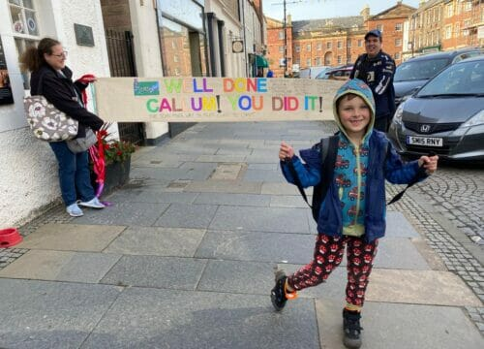

Citizenship
ECO
Callum Isted – Campaigning for Schools to give children reusable water bottles
https://superkind.org/change-makers/callum-isted
Notes:
Click on the link for the video and then create a short task/question based on the video.

Slide 4


Citizenship
Safeguarding
Water Safety | KS1 | https://learnliveuk.com/water-safe-friendly/ (input bkershawma@theparkfederation.org to access)
 | KS2 | https://learnliveuk.com/water-safe-friendly/ (input bkershawma@theparkfederation.org to access)
Notes:
Click on the link for the video and then create a short task/question based on the video.

Slide 5
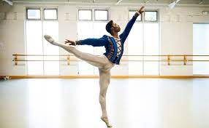

Citizenship
Arts
https://www.youtube.com/watch?v=LLouywuk5js
Notes:
Click on the link for the video and then create a short task/question based on the video.

Slide 6
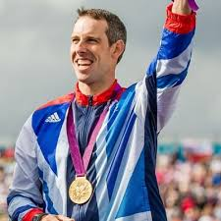

Citizenship
Sports
Etienne Stott
https://www.youtube.com/watch?v=tTuuviHxgGQ&list=PLcvEcrsF_9zLiSsK0i03cYRbzLhVRIfQE&index=6
Notes:
Click on the link for the video and then create a short task/question based on the video.

