Slide 1





Citizenship
Week 1
Everyone to Excel through Pride and Ambition

Slide 2

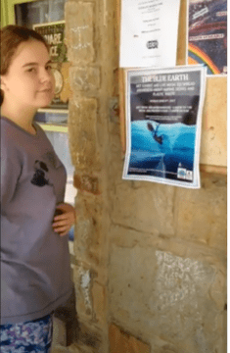

Citizenship
ECO
Blue Brasher – Raising Awareness about Plastic Pollution
https://superkind.org/change-makers/blue-brasher
Notes:
Click on the link for the video and then create a short task/question based on the video.

Slide 3
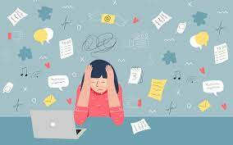

Citizenship
Safeguarding
Feeling worried | KS1 Link | https://www.bbc.co.uk/teach/class-clips-video/pshe-eyfs-ks1-feeling-worried/zb6ngwx
Stress and Anxiety | KS2 Link | https://www.childline.org.uk/toolbox/videos/managing-stress-anxiety/
Notes:
Click on the link for the video and then create a short task/question based on the video.

Slide 4
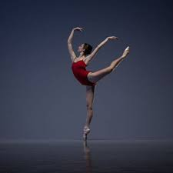

Citizenship
Arts
https://www.youtube.com/watch?v=ZMQy0dgvskQ
Notes:
Click on the link for the video and then create a short task/question based on the video.

Slide 5
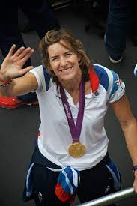

Citizenship
Sports
Katherine Grainger
https://www.youtube.com/watch?v=euNNkDyVjW0&list=PLcvEcrsF_9zLiSsK0i03cYRbzLhVRIfQE&index=4
Notes:
Click on the link for the video and then create a short task/question based on the video.

