Slide 1





Citizenship
Week 2
Everyone to Excel through Pride and Ambition

Slide 2


Citizenship
Inclusion
https://www.youtube.com/watch?v=LGetnPl5GjE KS1
https://www.youtube.com/watch?v=cYpd1_XR5pg KS2
Notes:
Click on the link for the video and then create a short task/question based on the video.

Slide 3
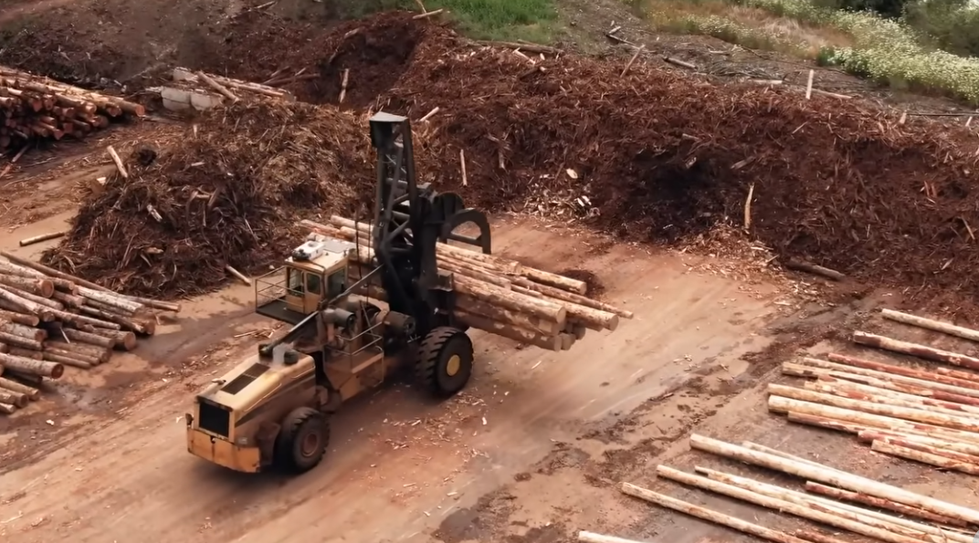

Citizenship
ECO
https://www.youtube.com/watch?v=QQYgCxu988s
Notes:
Click on the link for the video and then create a short task/question based on the video.

Slide 4

Citizenship
Safeguarding
https://www.youtube.com/watch?app=desktop&v=-lL07JOGU5o&feature=youtu.be KS1
https://www.bbc.co.uk/newsround/av/56527816 KS2
Notes:
Click on the link for the video and then create a short task/question based on the video.

Slide 5


Citizenship
Arts
https://www.youtube.com/watch?v=JOEN1q9WnmI
Notes:
Click on the link for the video and then create a short task/question based on the video.

