Slide 1





Citizenship
Week 3
Everyone to Excel through Pride and Ambition

Slide 2

Citizenship
Inclusion
Living with a Disability | https://www.youtube.com/watch?v=7M6mN3JrOUQ

Slide 3

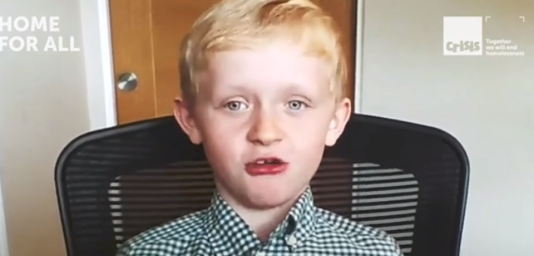

Citizenship
ECO
Henry Clearly – run a marathon to raise money for homeless charity.
https://superkind.org/change-makers/henry-cleary
Notes:
Click on the link for the video and then create a short task/question based on the video.

Slide 4


Citizenship
Safeguarding
KS1 Link | https://www.youtube.com/watch?v=IqHh5ki_y20
KS2 Link | https://www.youtube.com/watch?v=GAXBz5kC3CQ
Notes:
Click on the link for the video and then create a short task/question based on the video.

Slide 5


Citizenship
Sports
https://drive.google.com/file/d/1OVOZNY5tx97QH8Ae7RsIUvUEOG7weLhs/view
Notes:
Click on the link for the video and then create a short task/question based on the video.

Slide 6


Citizenship
Arts
21ST JUNE - WORLD MUSIC DAY
https://www.youtube.com/watch?v=DdgLftWXccQ
Notes:
Click on the link for the video and then create a short task/question based on the video.

