Slide 1





Citizenship
Week 6
Everyone to Excel through Pride and Ambition

Slide 2

Citizenship
Inclusion
Autism Day
2nd April 2024
https://www.youtube.com/watch?v=Ezv85LMFx2E

Slide 3

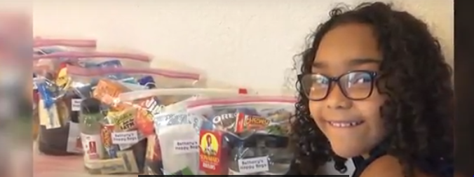

Citizenship
ECO
Bethany Moultry – Bethany’s Happy Bags
https://superkind.org/change-makers/bethany-moultry
Notes:
Click on the link for the video and then create a short task/question based on the video.

Slide 4


Citizenship
Safeguarding
Childline | KS1 Link | https://www.childline.org.uk/toolbox/videos/contacting-childline/
 | KS2 Link
Notes:
Click on the link for the video and then create a short task/question based on the video.

Slide 5
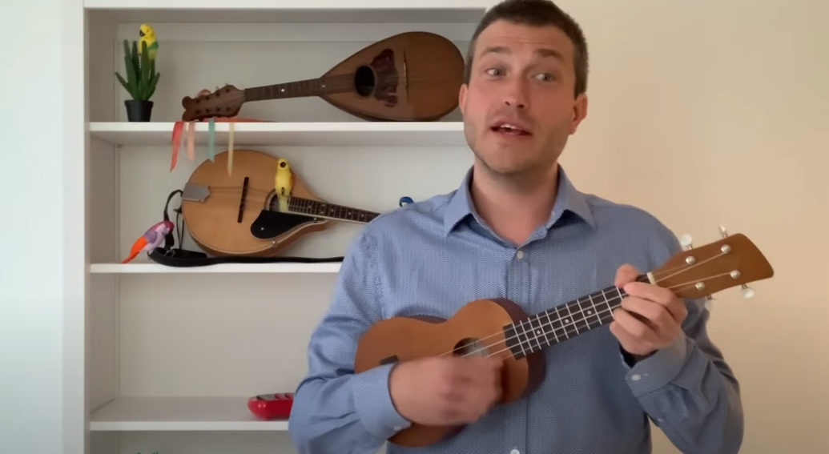

Citizenship
Arts
https://www.youtube.com/watch?v=VO0whvQ3QJA
Watch 25-30
Notes:
Click on the link for the video and then create a short task/question based on the video.

