Slide 1





Citizenship
Week 2
Everyone to Excel through Pride and Ambition

Slide 2
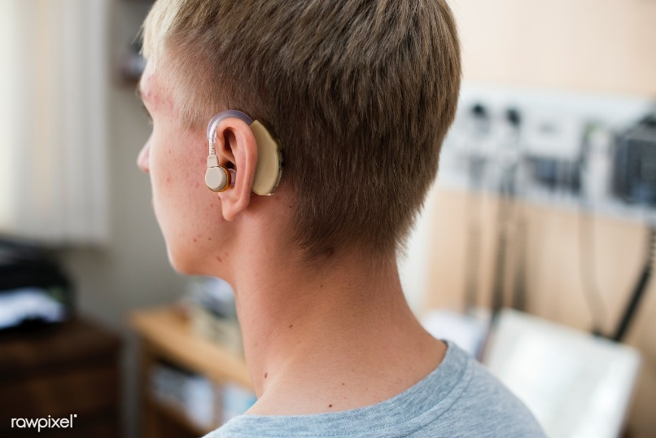

Citizenship
Inclusion
KS1 Link | https://www.youtube.com/watch?v=Hrgqs4MmK3U
KS2 Link
Notes:
Click on the link for the video and then create a short task/question based on the video.

Slide 3


Citizenship
ECO
Kids Take Action Against Ocean Plastic | Short Film Showcase - YouTube
Notes:
Click on the link for the video and then create a short task/question based on the video.

Slide 4


Citizenship
Safeguarding
KS1 Link | https://www.think.gov.uk/resource/safer-journeys-anthem/
KS2 Link | https://www.think.gov.uk/resource/first-journeys/
Notes:
Click on the link for the video and then create a short task/question based on the video.

Slide 5
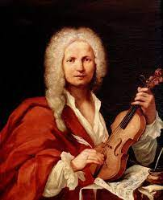

Citizenship
Arts
Vivaldi:
https://www.youtube.com/watch?v=KKxcS49Vpkc
Notes:
Click on the link for the video and then create a short task/question based on the video.

Slide 6

Citizenship
Sports
https://drive.google.com/file/d/1DpT44cCTcGp4WL0mXT4rxpkN5VopVlGP/view?usp=drive_link
Notes:
Click on the link for the video and then create a short task/question based on the video.

