Slide 1





Citizenship
Week 7
Everyone to Excel through Pride and Ambition

Slide 2

Citizenship
Inclusion
Diversity | KS1 Link | https://www.bbc.co.uk/bitesize/topics/zhfdjsg/articles/zqkptrd (first video on the page - 'Exploring differences')
 | KS2 Link | https://www.bbc.co.uk/bitesize/topics/zyg2xbk/articles/z9dpn9q (first video on the page - 'Explore diversity')
YEAR 6 | https://www.youtube.com/watch?v=mhQpKizLC4s

Slide 3

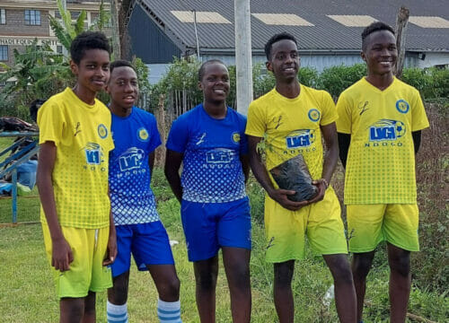

Citizenship
ECO
Lesein Mutunkei – plants trees every time he scores a football goal.
https://superkind.org/change-makers/lesein-mutunkei
Notes:
Click on the link for the video and then create a short task/question based on the video.

Slide 4
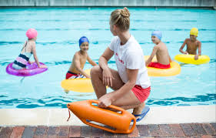

Citizenship
Safeguarding
Pool Safety | KS1 Link | https://www.youtube.com/watch?v=y8EnnUaHK4k
 | KS2 Link
Notes:
Click on the link for the video and then create a short task/question based on the video.

Slide 5
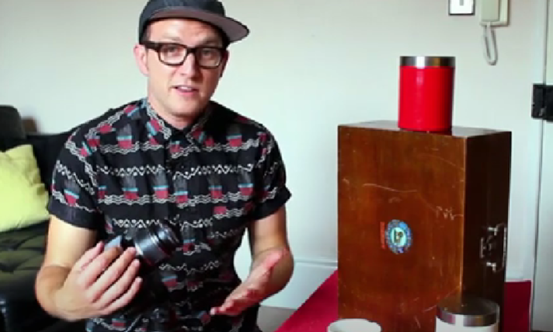

Citizenship
Arts
https://www.youtube.com/watch?v=67OdLh__YG4
Notes:
Click on the link for the video and then create a short task/question based on the video.

Slide 6
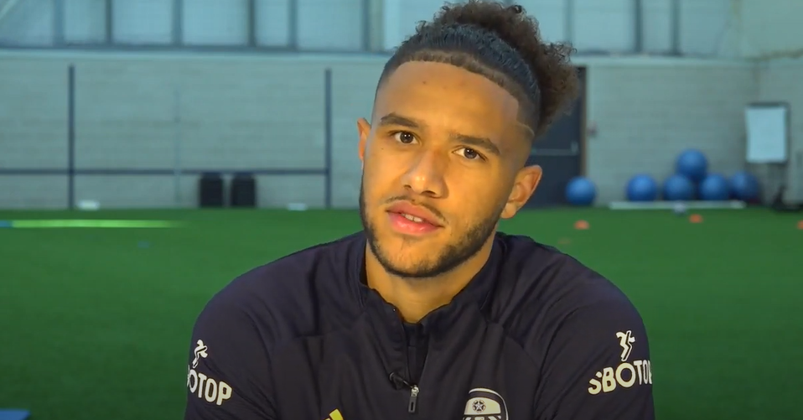

Citizenship
Sports
https://drive.google.com/file/d/1scThTNxNZg9OfZ1GTmsT4fnYk9chrvzn/view
Notes:
Click on the link for the video and then create a short task/question based on the video.

