Slide 1





Citizenship
Week 4
Everyone to Excel through Pride and Ambition

Slide 2

Citizenship
Inclusion
https://www.bbc.co.uk/bitesize/topics/zpywqfr/articles/z9b2qfr (first video - 'Explore fairness’) KS1
https://www.bbc.co.uk/bitesize/topics/zyg2xbk/articles/z8yjdp3 (first video - Exploring discrimination) KS2
Notes:
Click on the link for the video and then create a short task/question based on the video.

Slide 3


Citizenship
ECO
https://www.youtube.com/watch?v=wzPUm-Ytpz4
Notes:
Click on the link for the video and then create a short task/question based on the video.

Slide 4

Citizenship
Safeguarding
https://www.youtube.com/watch?app=desktop&v=SY7RhBszp0k KS1 https://www.youtube.com/watch?app=desktop&v=dkraVxm8If4 KS1
https://www.bbc.co.uk/newsround/44074704 (3rd video down) KS2
Notes:
Click on the link for the video and then create a short task/question based on the video.

Slide 5
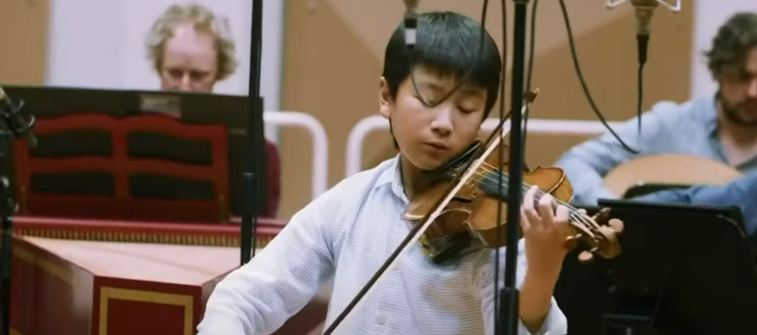

Citizenship
Arts
https://www.youtube.com/watch?v=aYgsU64EdMg
Notes:
Click on the link for the video and then create a short task/question based on the video.

Slide 6

Citizenship
Sports
https://drive.google.com/file/d/1IJe9GJ0m2ZI11szCfiudalRIv1Jp6Rzy/view?usp=drive_link
Notes:
Click on the link for the video and then create a short task/question based on the video.

