Slide 1





Citizenship
Week 6
Everyone to Excel through Pride and Ambition

Slide 2
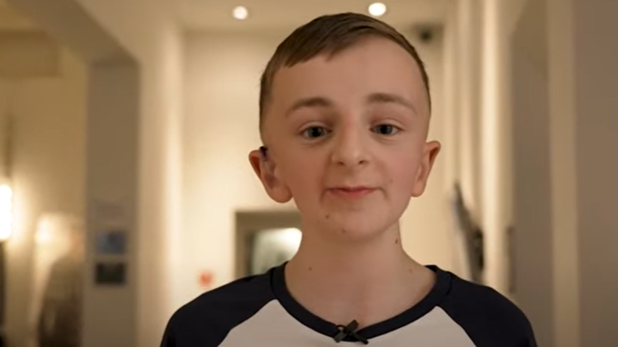
Citizenship
Inclusion
Accessibility for all | KS1 Link | https://www.youtube.com/watch?v=uxDav-2a-BM&list=PL-2SkY8uS2lLCRjs_x009gOMRLUjPktrB&index=4
 | KS2 Link
 | YEAR 6 | https://www.youtube.com/watch?v=yqkRx6sfMpQ

Slide 3

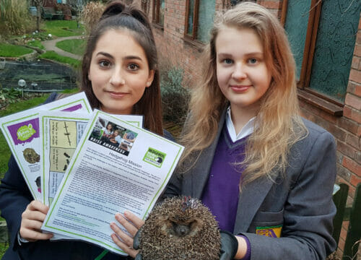

Citizenship
ECO
Kyra Barboutis and Sophie Smith – saving the lives of hundreds of hedgehogs in the UK.
https://superkind.org/change-makers/kyra-barboutis-sophie-smith
Notes:
Click on the link for the video and then create a short task/question based on the video.

Slide 4


Citizenship
Safeguarding
Safety in the Sun | KS1 Link | https://www.youtube.com/watch?v=T7ghJsZug60
 | KS2 Link | https://www.youtube.com/watch?v=DzuyD-1fCo4
Notes:
Click on the link for the video and then create a short task/question based on the video.

Slide 5


Citizenship
Arts
https://www.youtube.com/watch?v=BAZAD9wRbwI
Notes:
Click on the link for the video and then create a short task/question based on the video.

Slide 6


Citizenship
Sports
https://drive.google.com/file/d/1KMOR9vQ2nfhZ7kdO2eFxtCUYD3-jWCMJ/view
Notes:
Click on the link for the video and then create a short task/question based on the video.

