Slide 1





Citizenship
Week 5
Everyone to Excel through Pride and Ambition

Slide 2
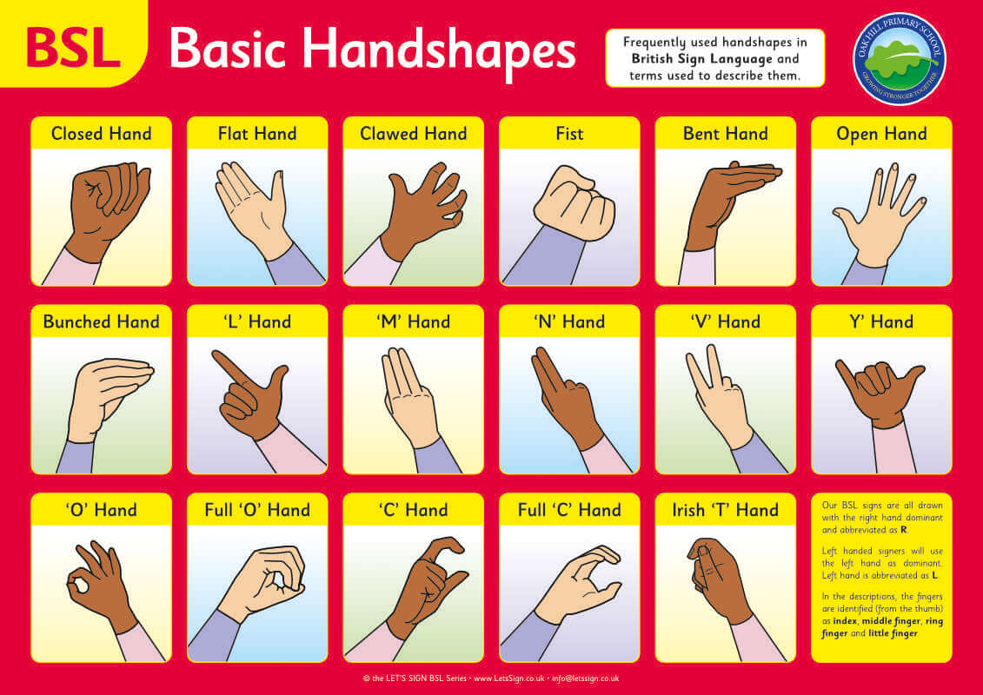

Citizenship
Inclusion
KS1 Link | https://www.youtube.com/watch?v=n09Rb3OTKfw
KS2 Link
Notes:
Click on the link for the video and then create a short task/question based on the video.

Slide 3
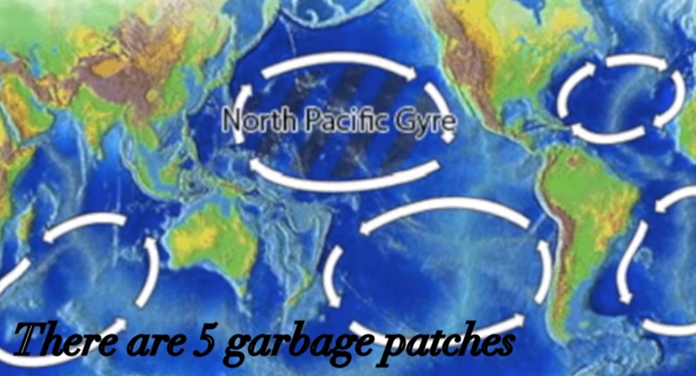

Citizenship
ECO
Great Pacific Garbage Patch - Ocean Pollution Awareness - YouTube
Notes:
Click on the link for the video and then create a short task/question based on the video.

Slide 4
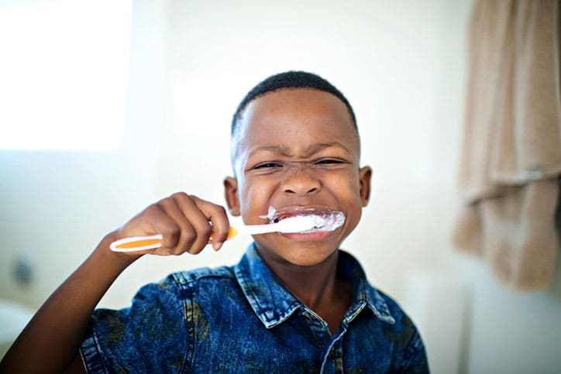

Citizenship
Safeguarding
KS1 Link | https://www.youtube.com/watch?v=aOebfGGcjVw
KS2 Link
Notes:
Click on the link for the video and then create a short task/question based on the video.

Slide 5
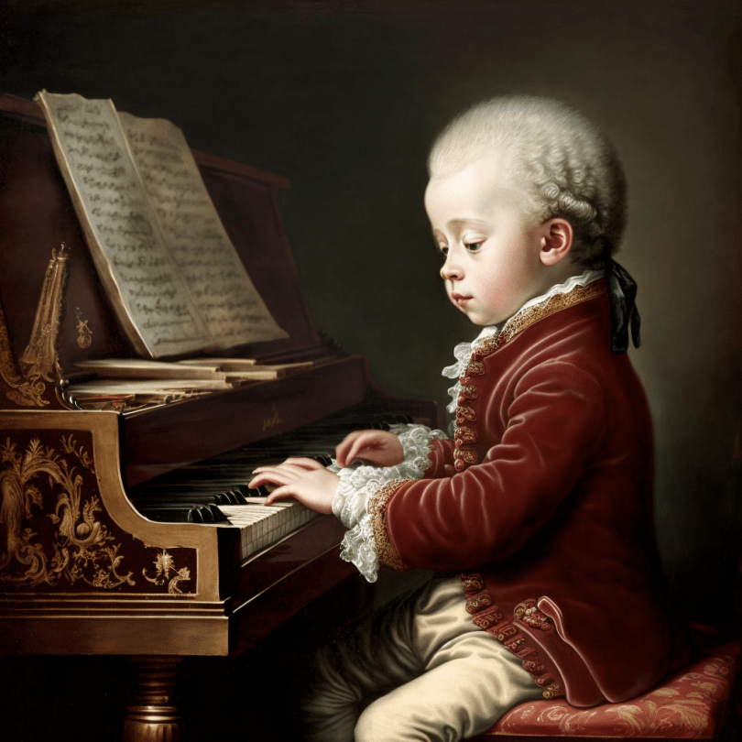

Citizenship
Arts
Mozart
https://www.youtube.com/watch?v=b8bQTsUBz0g
Notes:
Click on the link for the video and then create a short task/question based on the video.

Slide 6
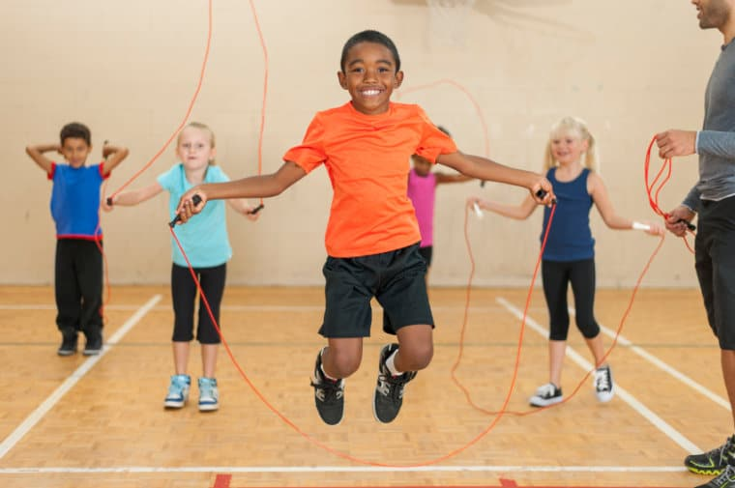

Citizenship
Sports
https://www.youtube.com/watch?v=U6nnRte5M70
PE makes you happier, healthier and smarter!
Notes:
Click on the link for the video and then create a short task/question based on the video.

