Slide 1





Citizenship
Week 2
Everyone to Excel through Pride and Ambition

Slide 2

Citizenship
Inclusion
Confidence and Self Esteem | KS1 Link | https://www.youtube.com/watch?v=Ud_eeFkzH4w
 | KS2 Link | https://www.youtube.com/watch?v=pdjaxS4ME2A

Slide 3

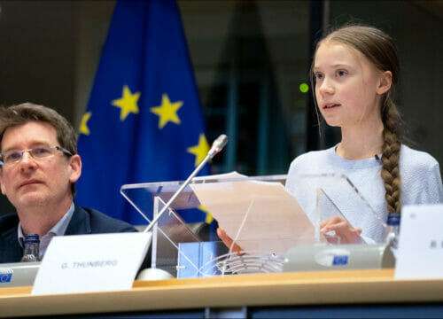

Citizenship
ECO
Greta Thunberg – campaigning for world leaders to act on climate change
https://superkind.org/change-makers/greta-thunberg
Notes:
Click on the link for the video and then create a short task/question based on the video.

Slide 4


Citizenship
Safeguarding
https://www.youtube.com/watch?v=dhpCdqOtuj0&list=PLQTtyDJWDJDZn1VvYzazcliJLwPXVrcCh&index=6
Notes:
Click on the link for the video and then create a short task/question based on the video.

Slide 5
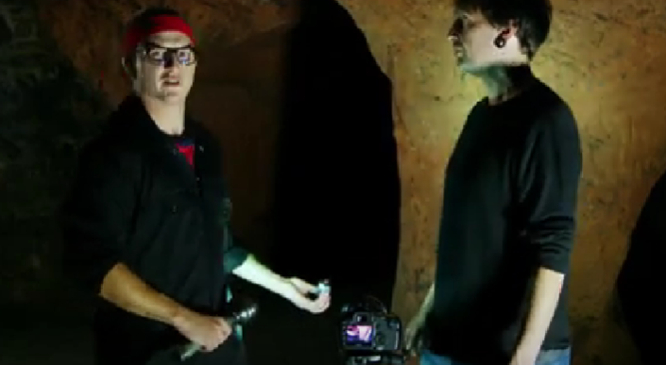

Citizenship
Arts
https://www.youtube.com/watch?v=r_nW9Kl3lEA
Notes:
Click on the link for the video and then create a short task/question based on the video.

Slide 6


Citizenship
Sports
https://drive.google.com/file/d/1ria3lcHaESWvjdCniSxX_iEZaJDNoMgb/view
Notes:
Click on the link for the video and then create a short task/question based on the video.

