Slide 1





Citizenship
Week 8
Everyone to Excel through Pride and Ambition

Slide 2

Citizenship
Inclusion
KS1 Link | https://www.bbc.co.uk/bitesize/topics/zpywqfr/articles/z9b2qfr (first video - 'Explore fairness')
KS2 Link | https://www.bbc.co.uk/bitesize/topics/zyg2xbk/articles/z8yjdp3 (first video - Exploring discrimination)

Slide 3

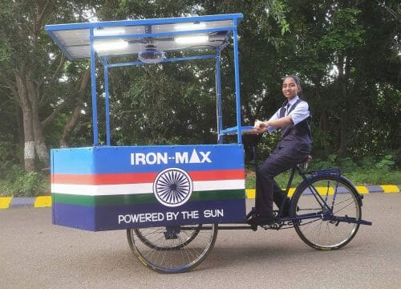

Citizenship
ECO
Vinisha Umashankar – designing a solar powered ironing cart to
reduce charcoal burning in India since she was 12.
https://superkind.org/change-makers/vinisha-umashankar
Notes:
Click on the link for the video and then create a short task/question based on the video.

Slide 4


Citizenship
Safeguarding
Road safety | KS2 Link | https://www.think.gov.uk/resource/expect-the-unexpected/
Road safety | KS1 Link | https://www.think.gov.uk/resource/safer-journeys-anthem/
Notes:
Click on the link for the video and then create a short task/question based on the video.

Slide 5
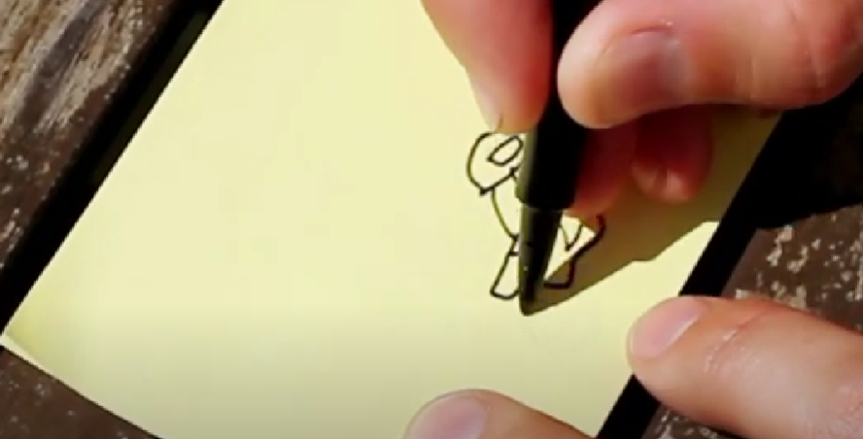

Citizenship
Arts
https://www.youtube.com/watch?v=GpGsy0eeTHU
Notes:
Click on the link for the video and then create a short task/question based on the video.

Slide 6
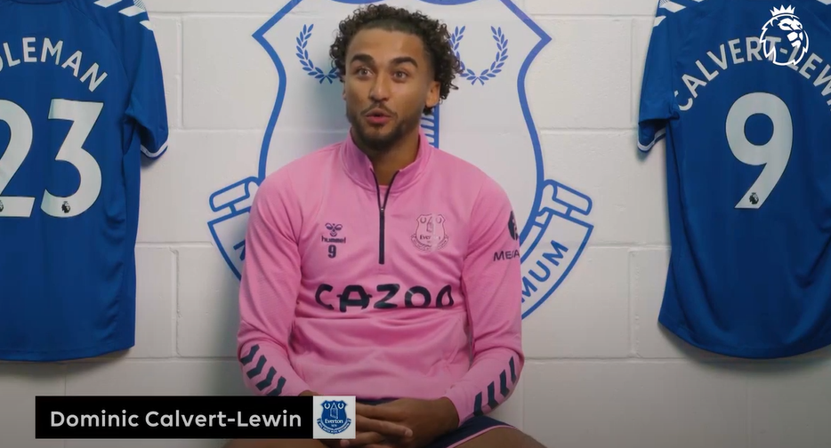

Citizenship
Sports
https://drive.google.com/file/d/138M6mpXOki1SAQbidAj8aSEJIqKhynaU/view
Notes:
Click on the link for the video and then create a short task/question based on the video.

